Slide 1
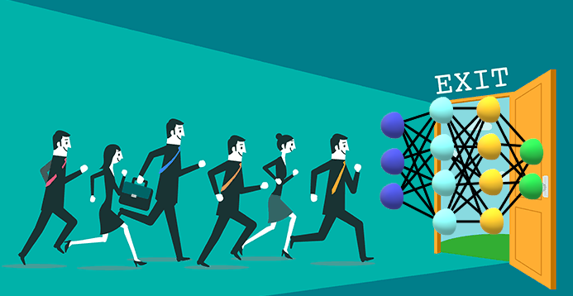
TELECOM CUSTOMER CHURN PREDICTION
SUBMITTED BY:-
1)Shubham kumar(13170069)
2)Prince kumar(12170053)
3)Rohit kumar(12170062)
4)Vishwas kumar(12170084)
GUIDED BY:- Ms ABITHA P.G

Slide 2
Contents:-
Introduction.
Tools used.
Dfd.
Pre-Processing.
Visualization.
Algorithm used.
Modular design.
Working.
Flask.
Deployment.
Conclusion.

Slide 3
INTRODUCTION
The word Customer Churn is the loss of clients or customers.
Telephone service companies, Internet service providers often use customer attrition analysis and customer attrition rates as one of their key business metrics because the cost of retaining an existing customer is far less than acquiring a new one.
We will use this project to help the companies to save their existing customers having high chance of churning

Slide 4
Contd…
Companies usually make a distinction between voluntary churn and involuntary churn
predictive analytics use churn prediction models that predict customer churn by assessing their propensity of risk to churn.
Since these models generate a small prioritized list of potential defectors, they are effective at focusing customer retention marketing programs.

Slide 5
TOOLS USED
Hardware and Software Requirements :
Hardware Interface
Server side :
Windows (or) Linux RAM : Min 4 GB
Software Requirements
• Front end: HTML, CSS,BOOTSTRAP.
• Back end: Python,FLASK,Json file,Model.h5 file.
• Operating System: Windows.

Slide 6
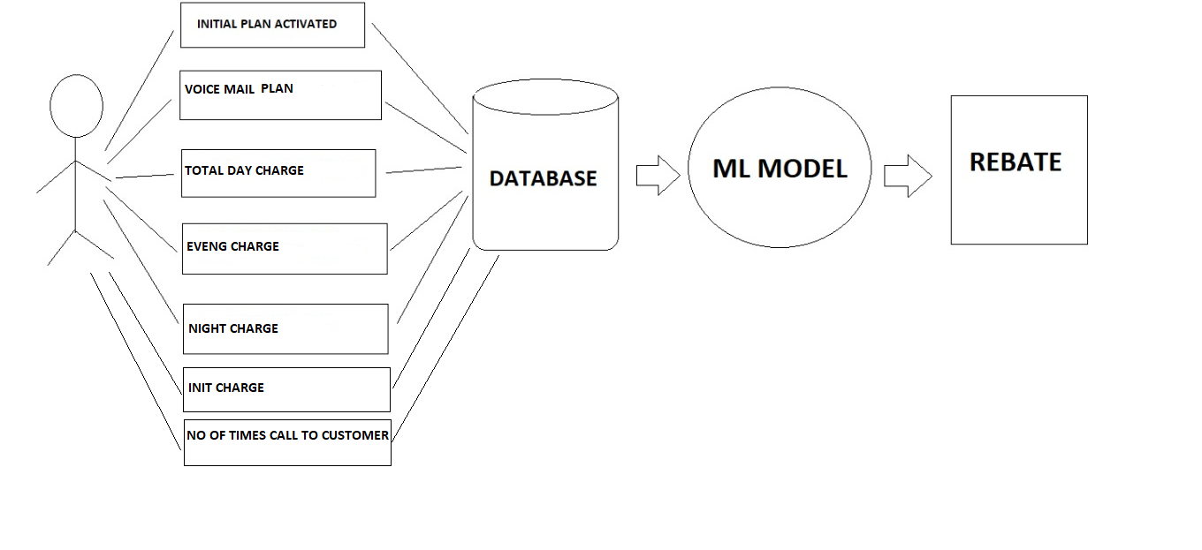
Block Diagram for Churn Prediction

Slide 7
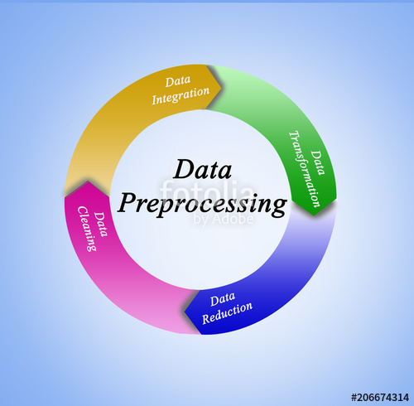
PRE-PROCESSING
WHY.........?
Many steps for pre-processing:
Data Cleaninng.
Data Integration.
Data Transformaion.
Data Reduction.
Data Clening
We will check if there is redundancy in data .
If there is missing columns , values or data .
Most widely used techniques are mean , median ,mode substitutions.

Slide 8
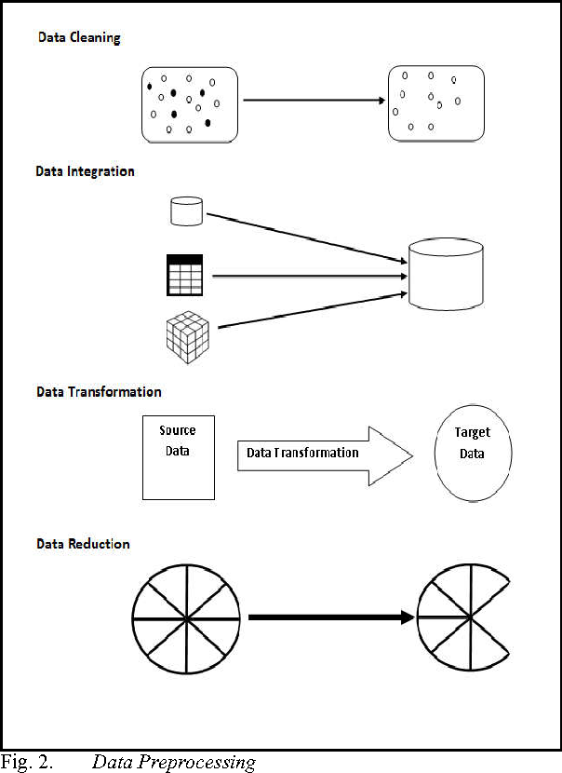
contd...
Data Transformation:
Max min normalization will be done on the data before the model starts its computations on the models.

Slide 9
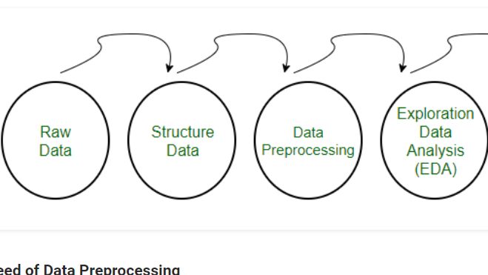
Contd…

Slide 10
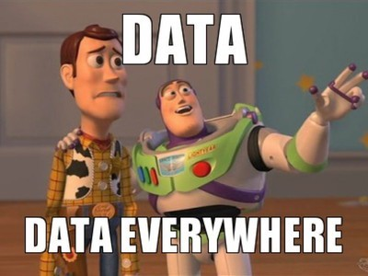
VISUALIZATION
Why.....?
Visualization lets us see things that would rather go unnoticed.
Easy to research data.
Gives answers faster.

Slide 11
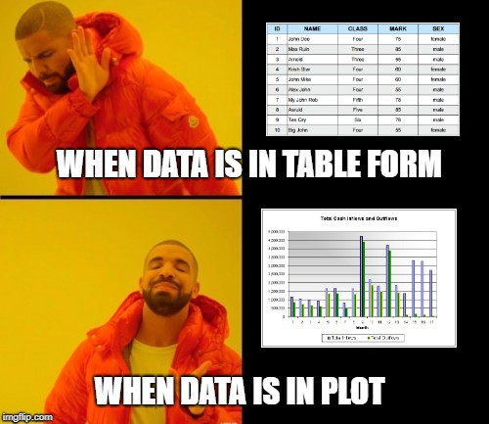
contd...
We used various graph , bar-graph , box plots and to visualize the data to check the inter dependency of each and every features with the people churning behaviour.

Slide 12
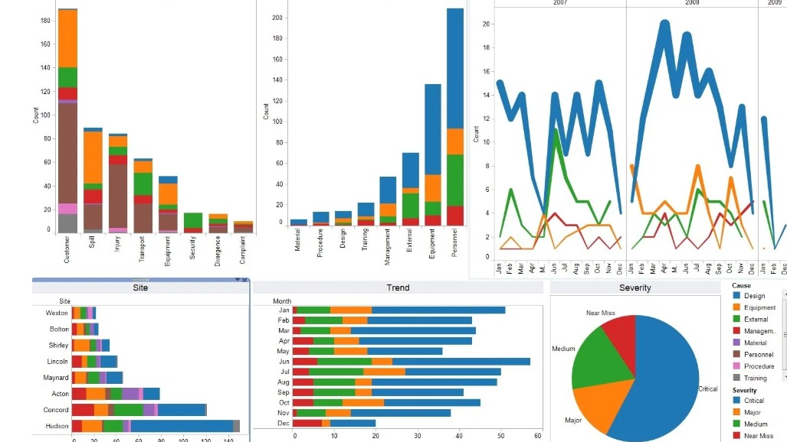
Visualization contd…

Slide 13
contd...
Bar graph:-
Box Plot:-

Slide 14
ALGORITHM USED:-
Since it is a supervised classification problem we used neural networks.
Neural networks gives best . so we used it for developing our models .Of all the features we get we will check for important attribute and use them for training and testing the algorithm . The best advantage of using neural networks is that it can update the weight on n number of iterations hence increasing its precision according to the epoches set.

Slide 15
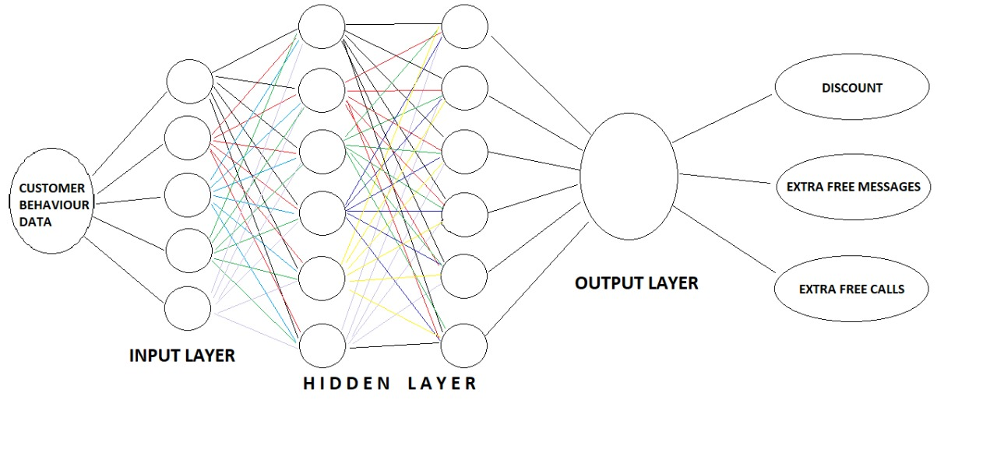
Neural Networks

Slide 16
Training and Testing set
We splited the data training and testing set in the ratio of 7:3 . we performed the operations on training model and will found ways to come closer to testing model without over fitting the model.
MODEL
The algorithm we used in evaluation is reccurant neural networks updating the weight and using the right no of epoches to get the best result of accuracy more than 90 percent.

Slide 17
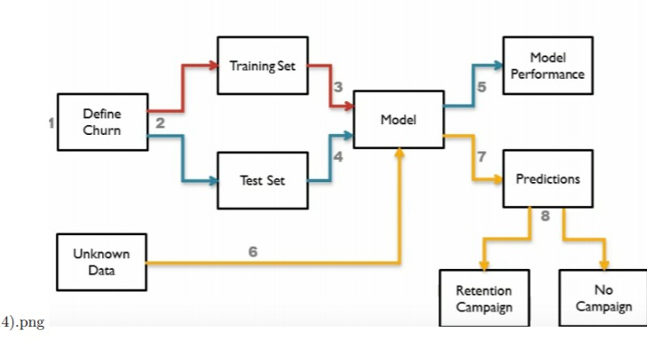
Modular Design for Churn Prediction

Slide 18
Modular Design
• Define Churn.
The database contains the 21 attribute of different behaviour of variety of customers some of which are
Time he spend in calling .
No of message he does normally .
Whether any initial plans are activated on his mobile
No of times he calls the customer support.

Slide 19
WORKING
Neurons:
Basic units of Neural Network.
A/q to the weight i/p the neurons adjust and update its activation function.
Activation Function:
Fire only when input will pass to true.
Used activation funcn- Rectified Linear Unit (ReLU).
ReLU:

Slide 20
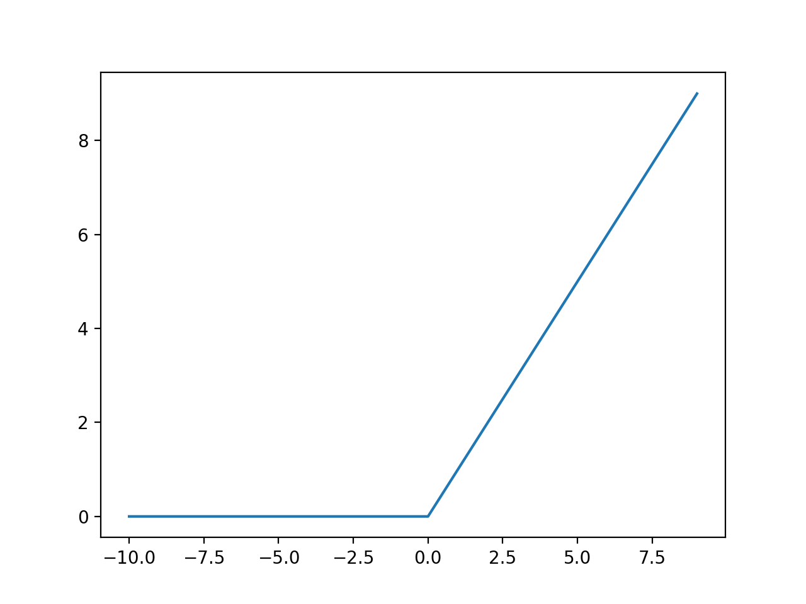
Relu Activation Graph

Slide 21
What is Relu function:-
Relu is activated on when a certain valueon input is reached.
for example in the above example for all the -ve valued input the relu function output is zero and will increase linearly on reaching a threshold.
The function must also provide more sensitivity to the activation sum input and avoid easy saturation.

Slide 22
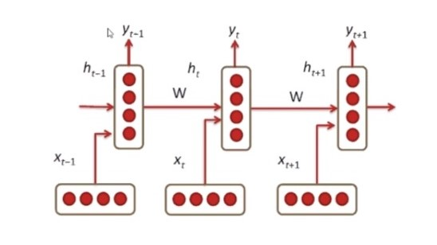
Back Propogation Working
The weight is tied to the different layers.
Condition the neural network on on previous data.

Slide 23
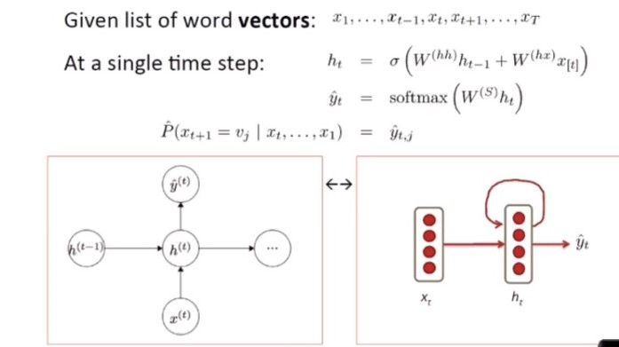
Learning at the Hidden Layer

Slide 24
Contd…
• Model Performance :
Various tests like f-score , precision , recall etc will be computed to check whether the model is not either under-fitting or over-fitting the model . If found so appropriate actions will be taken and again the models will compute till we don’t have good score of all these values.
• Unknown data :
After the model is found to be fit on all the parameters the model will be used to evaluate the probability of end users like a company which will input the new data of different customers and our model will precisely calculate their probability of not churning.

Slide 25
Contd…
• Retaining and No campaign After the models generate the result according to company policy we gave rebate ,more free minutes to call , free messages , cheaper internet facilities etc on the basis of their probability of churning .

Slide 26
Flask and its uses :
Flask is a Python-based micro framework which we will use for developing small scale websites.
Flask is very easy to make Restful API’s using python.
Before starting with the coding part, we need to download flask and some other libraries.
Here, we make use of virtual environment, where all the libraries are managed and makes both the development and deployment job easier.

Slide 27
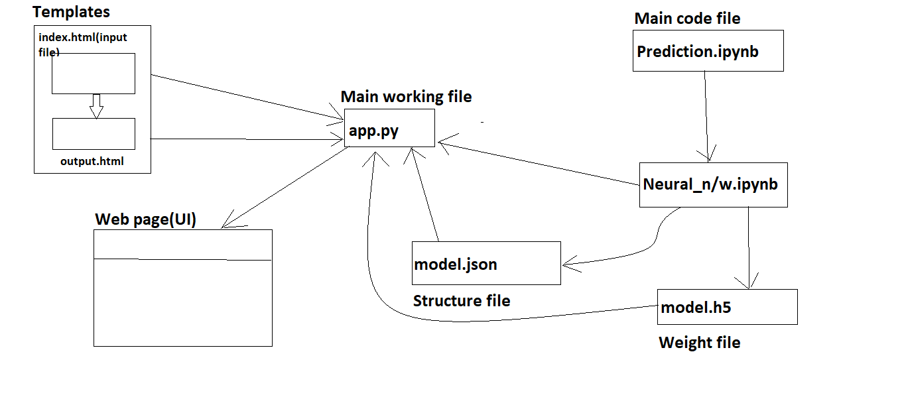
Deployment:-

Slide 28
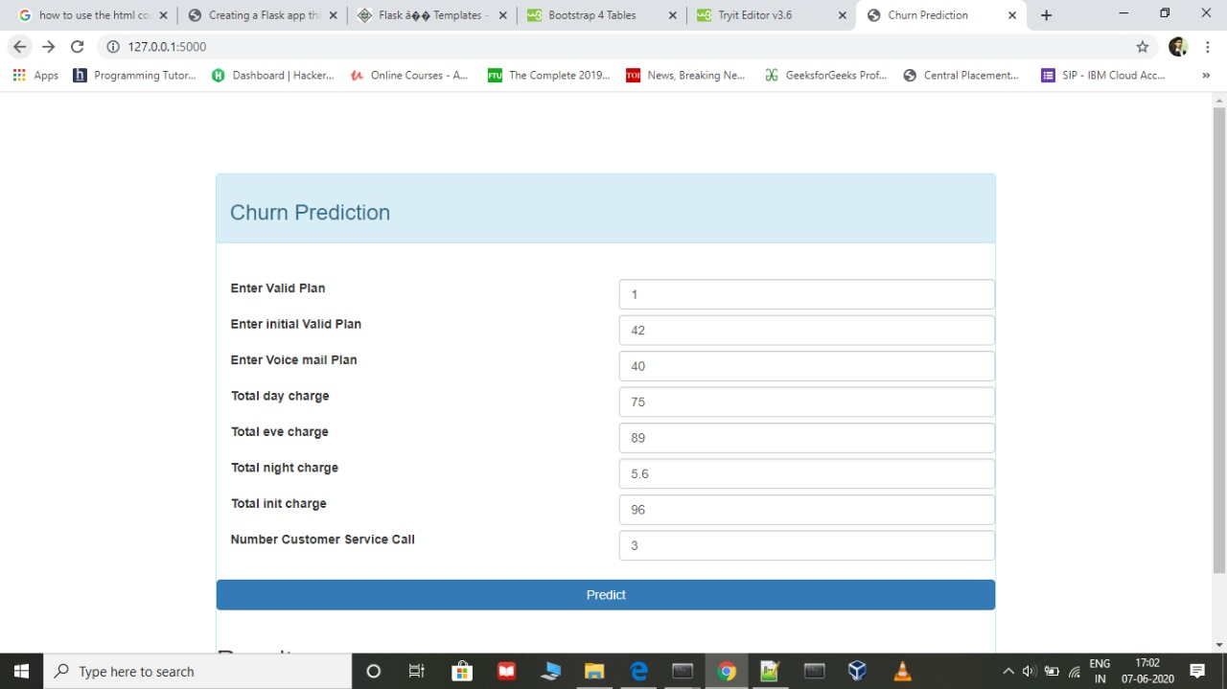
Contd...

Slide 29
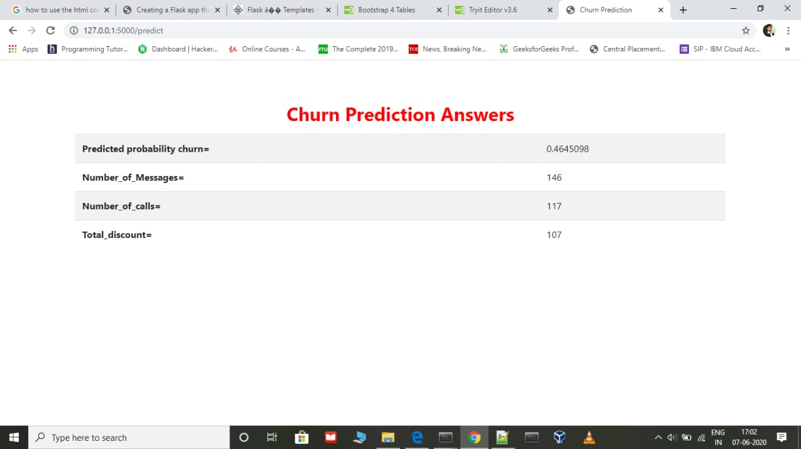
Contd…

Slide 30
CONCLUSION
In this project a web page providing UI that can take the user inputs has been developed , and gives optimal probability for churning of custemer.
This project can be used by telecom companies and they can optimize there profit and retain there customer.

Slide 31
FUTURE WORK:-
Can we improve the approach further?
This can be improvised by continuous feedback implementation to identify the future trends and with the additional attributes.
Can we get better data to design an improved solution?
We can request the additional data from the customer to use the extra features to improvise the solution.
Can we try any other experimental settings like some other pre-processing steps?
The customer datasets might have missing values, those can be handled with imputation techniques as a pre-processing steps and the proper imputation methods and other pre-processing steps can be considered to best improvise the model.

Slide 32
References
[1] C. F. T. a. Y. H. Lu, ”Customer churn prediction by hybridneural networks,” Expert Systems Application, vol. 36, no. 10, p.12547—12553, 2009.
[2] M. T. K. a. B. B. B. Huang, ”Customer churn predictionin telecommunications,” Expert Systems with Applications, vol. 39, no. 1, pp.1414-1425, 2012.
[3] P. K. a. I. Y. Topcu, ”Applying Bayesian belief network approach to customer churn analysis: a case study on the telecomindustry of Turkey.,” Expert Systems with Applications, vol. 38, no. 1,pp. 7151-7157, 2010.

Slide 33
THANKS

